Slide 1
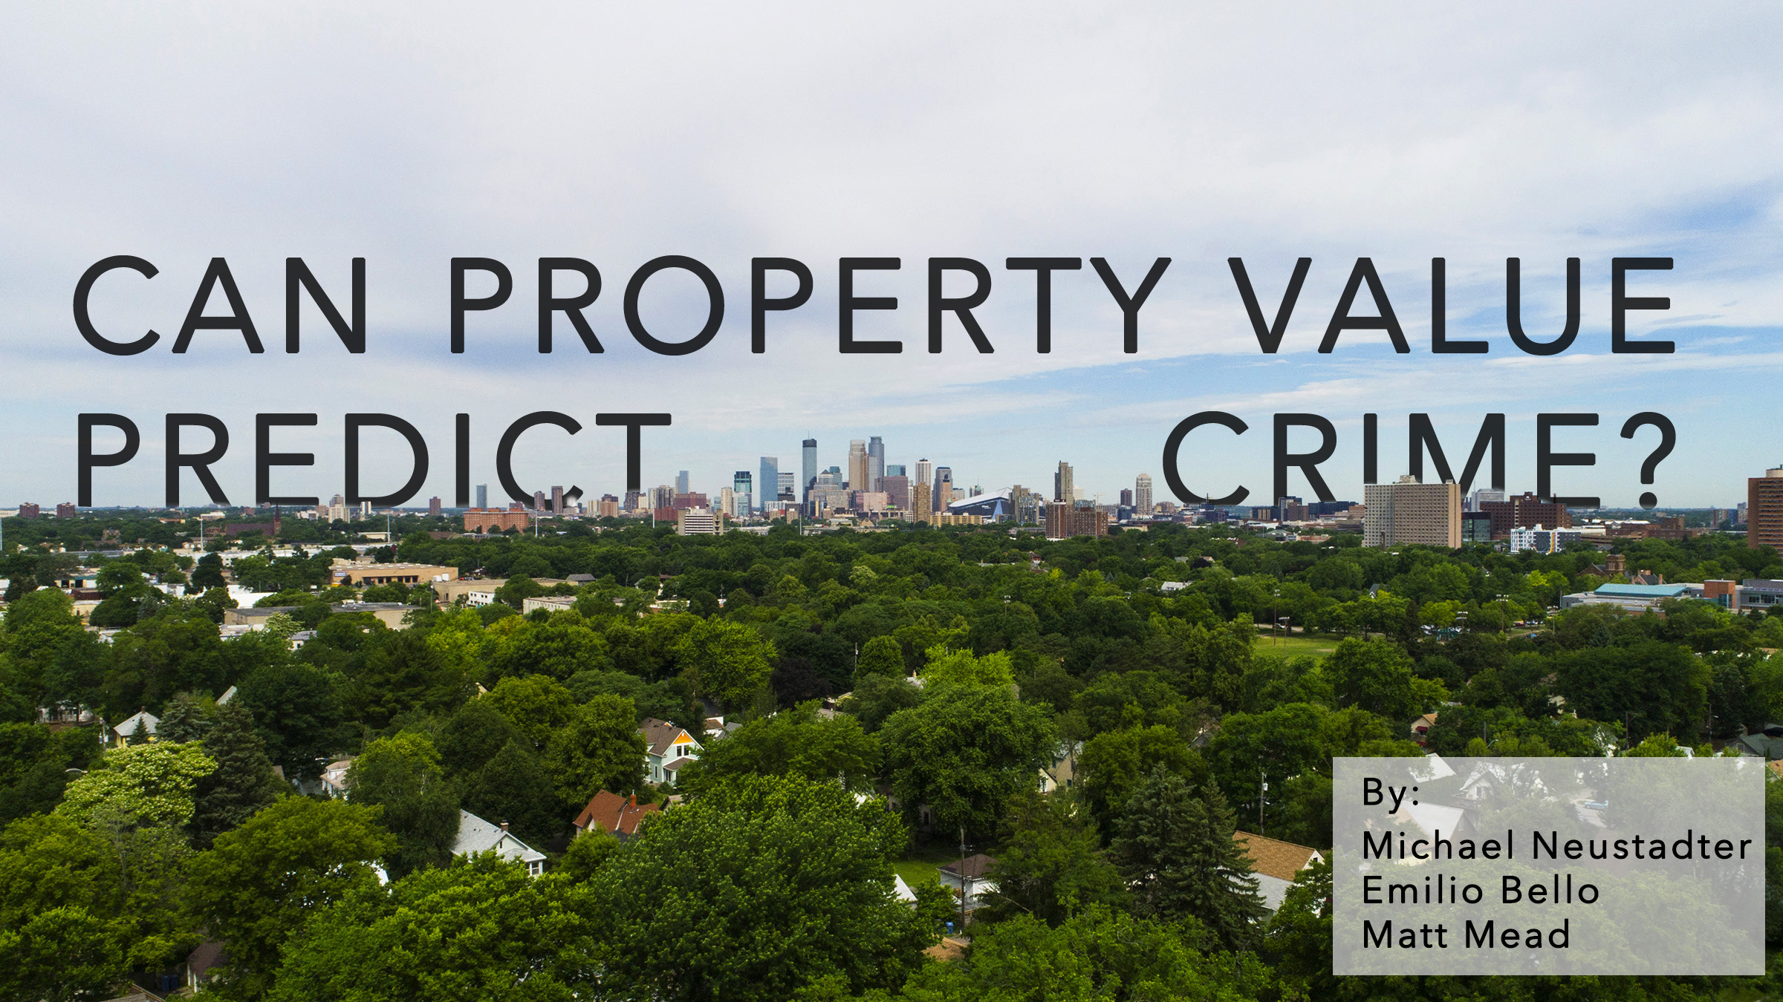

Slide 2
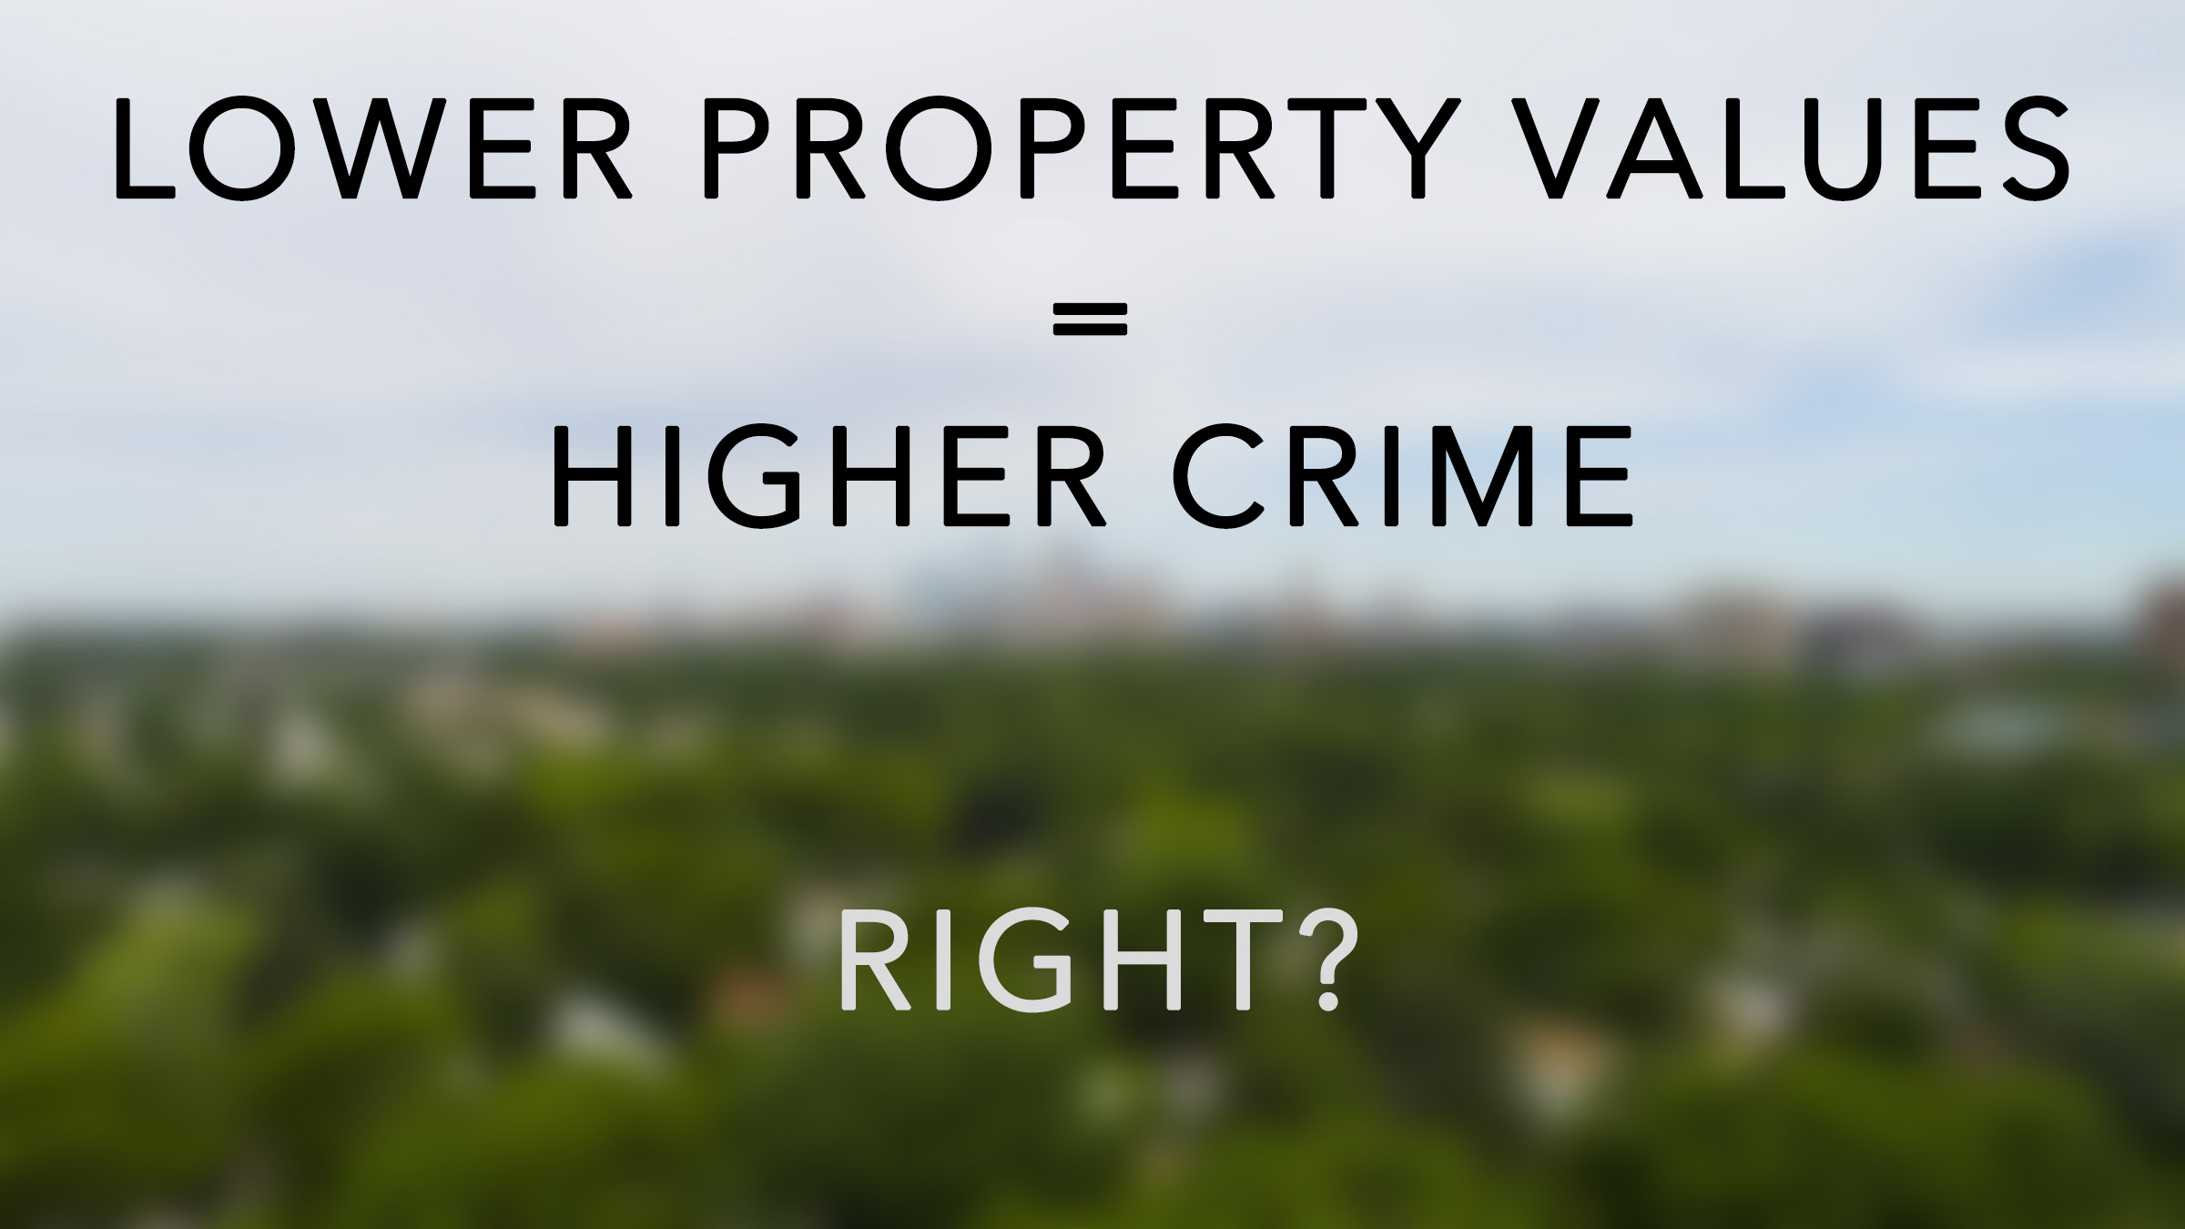
RIGHT?

Slide 3


Slide 4
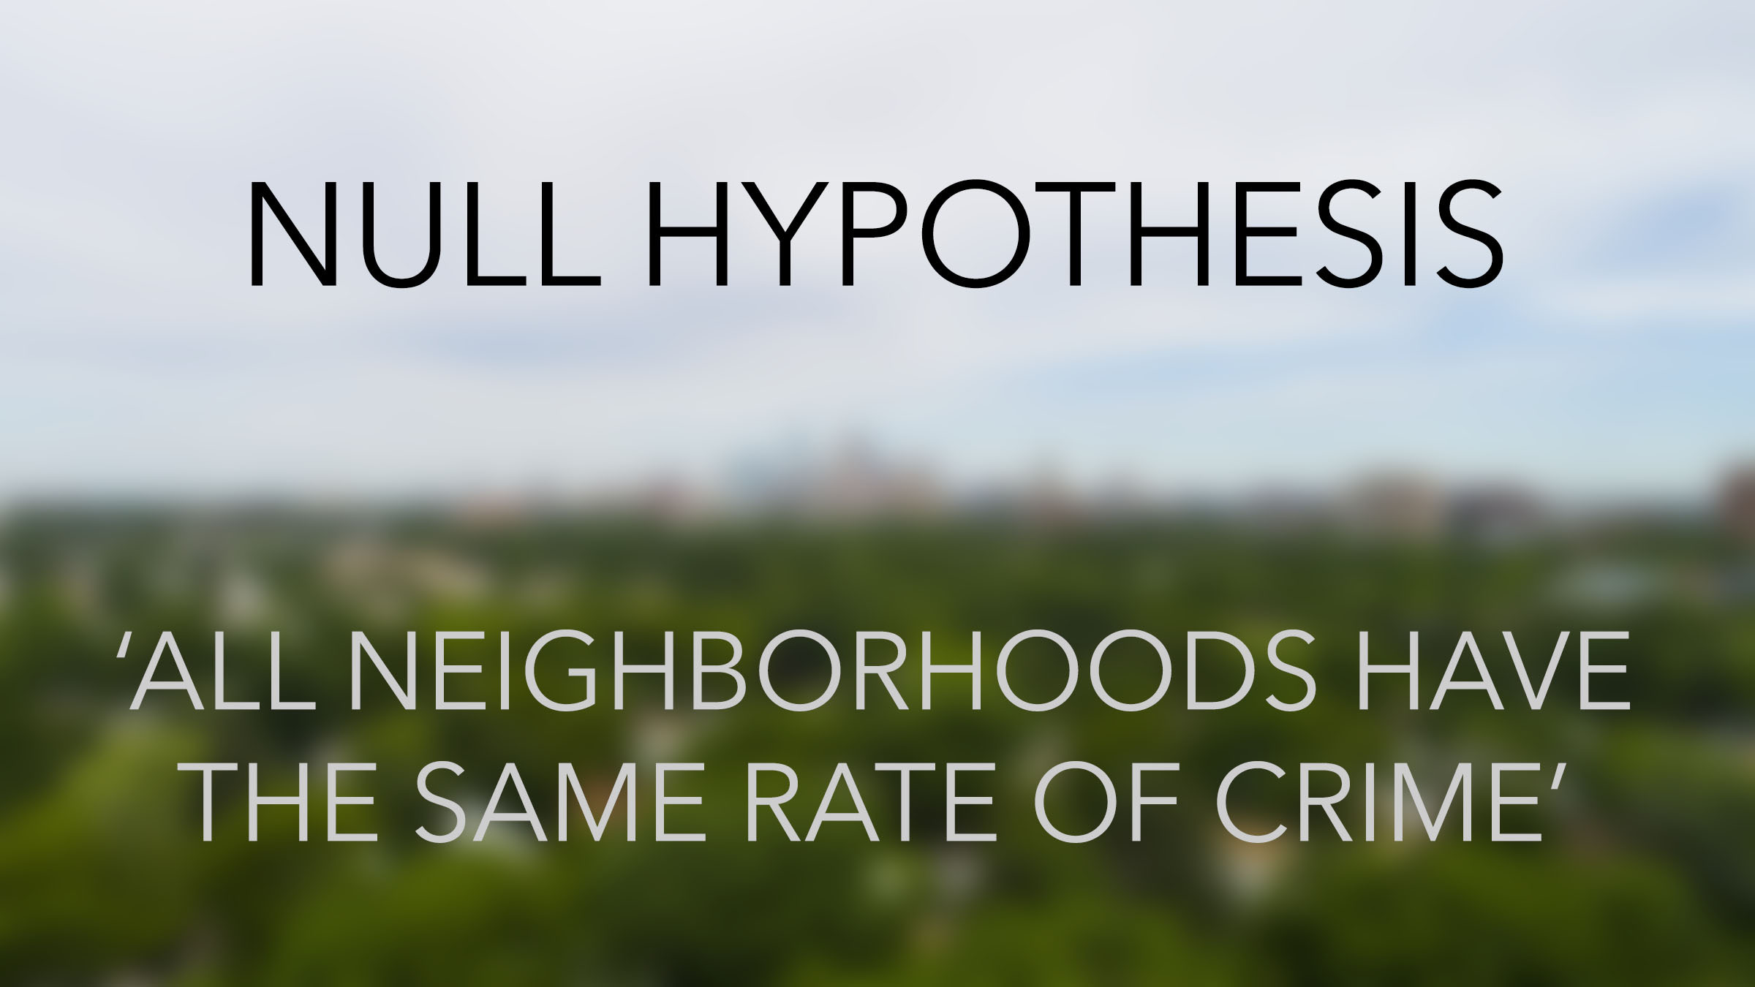
“ALL NEIGHBORHOODS HAVE THE SAME AMOUT OF CRIME”

Slide 5

DATA SETS
http://opendata.minneapolismn.gov/

Slide 6
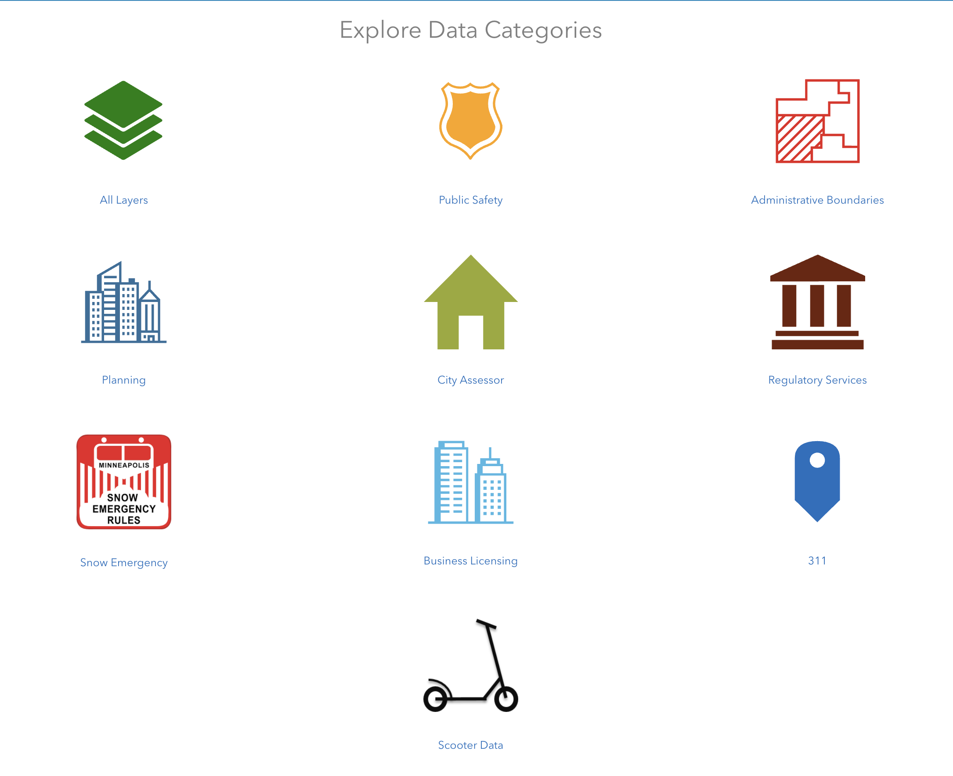
DATA SETS
Crime: 2010-2020
Parcel: 2017-2020

Slide 7
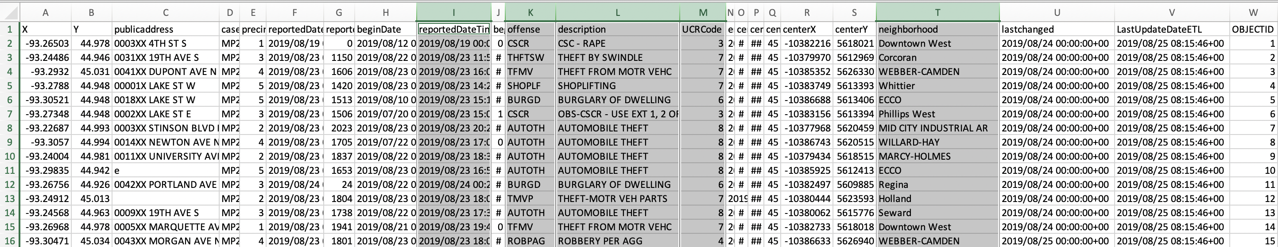
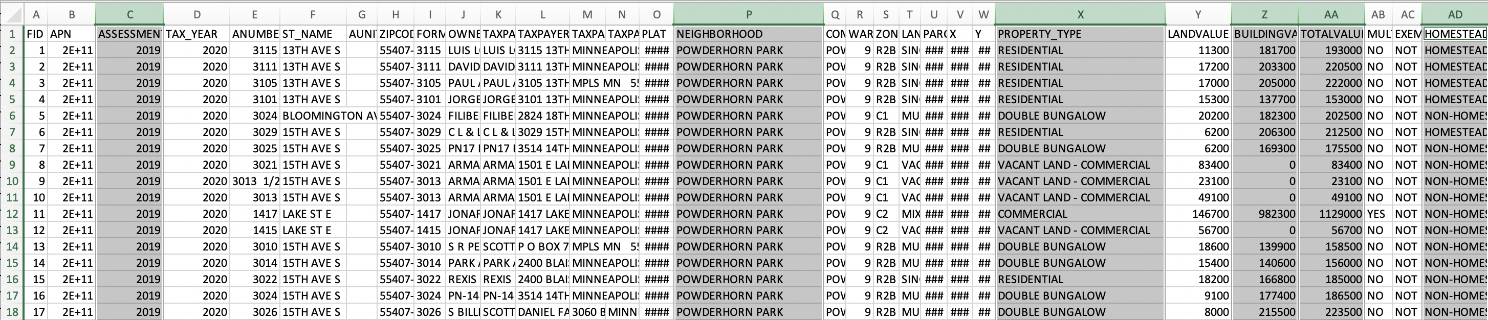
DATA SETS
Crime Data
Parcel Data

Slide 8
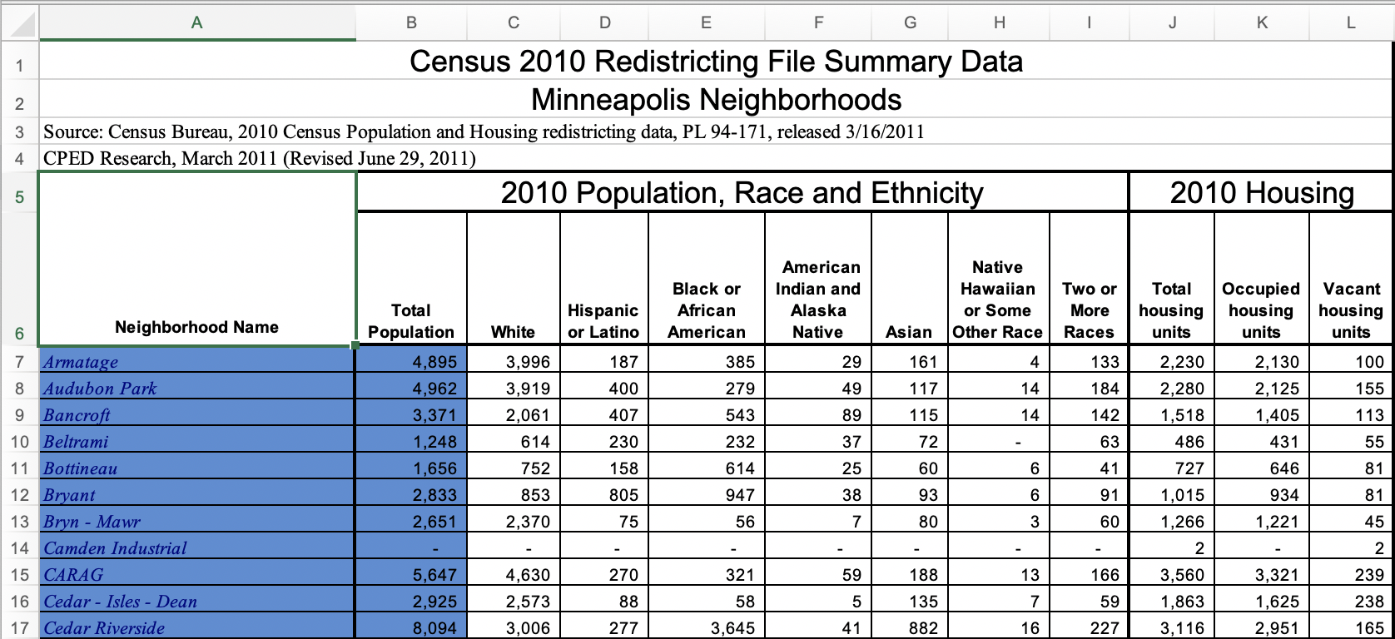
DATA SETS
http://www2.minneapolismn.gov/census/2010/census_2010#top

Slide 9
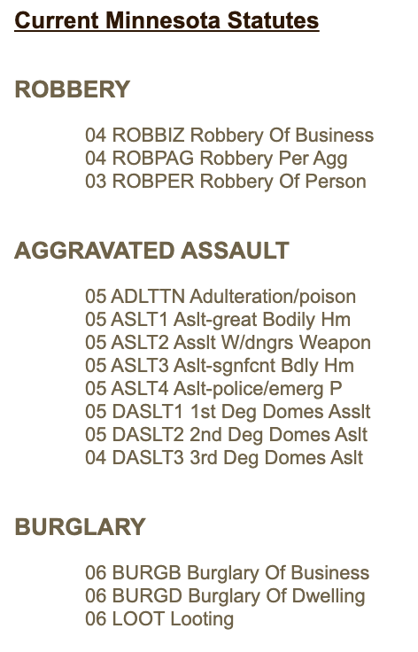
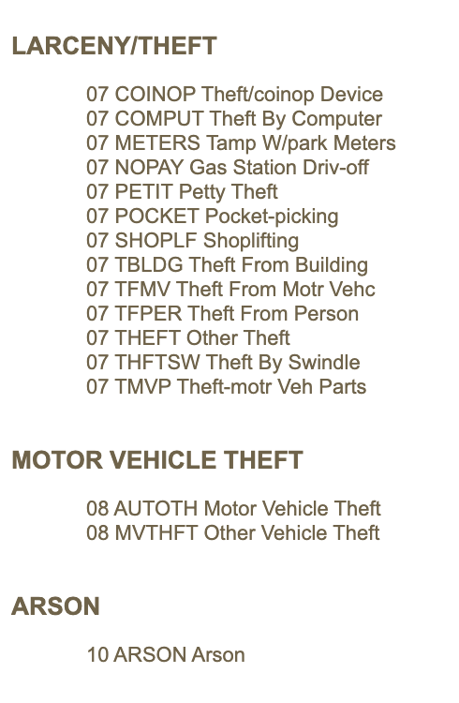
DATA SETS
https://www.maquah.net/race/codes.html

Slide 10
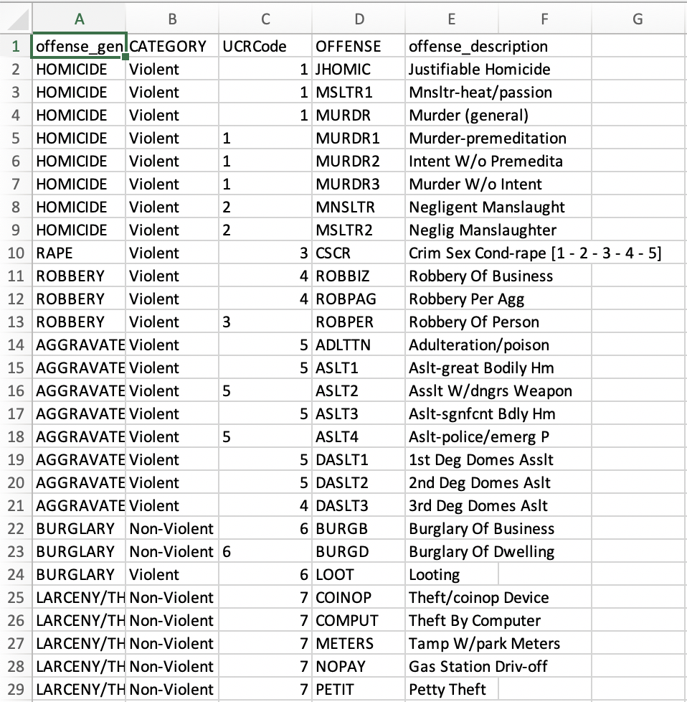
DATA SETS
https://www.maquah.net/race/codes.html
Classifying different crimes as Violent vs. Non-Violent and pairing with ”Offense”

Slide 11


Slide 12
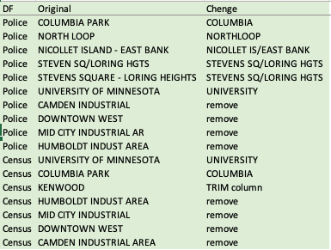
DATA CLEANING
Renamed and strip white space

Slide 13
DATA CLEANING
Property Types included:
Apartment Buildings
Industrial Buildings
Commercial Buildings
Vacant Land (Building Value = 0)

Slide 14

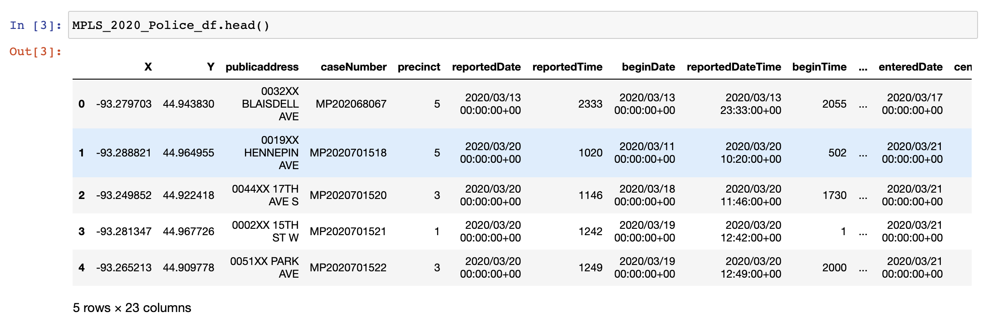
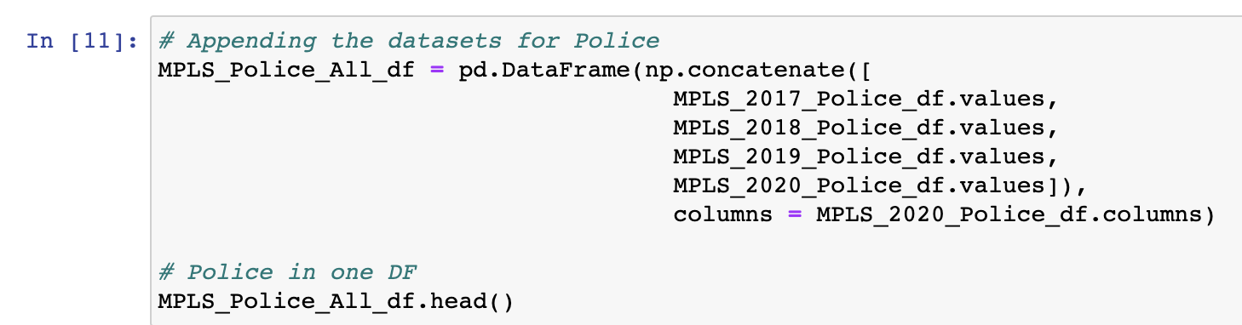
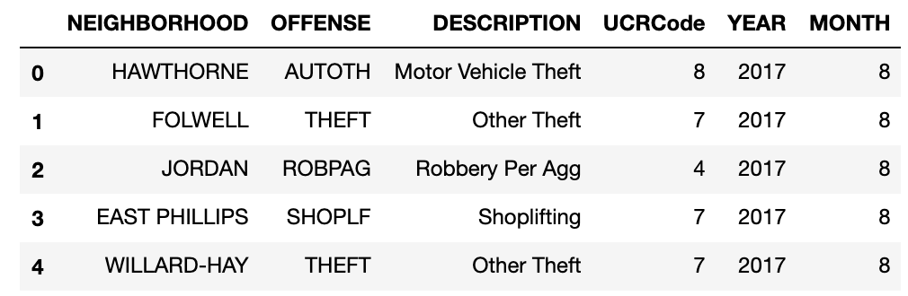
DATA CLEANING
Getting What We Need
Combine all
Data Frames
Grab only values we want

Slide 15
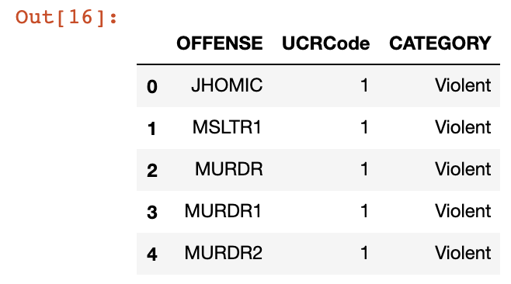
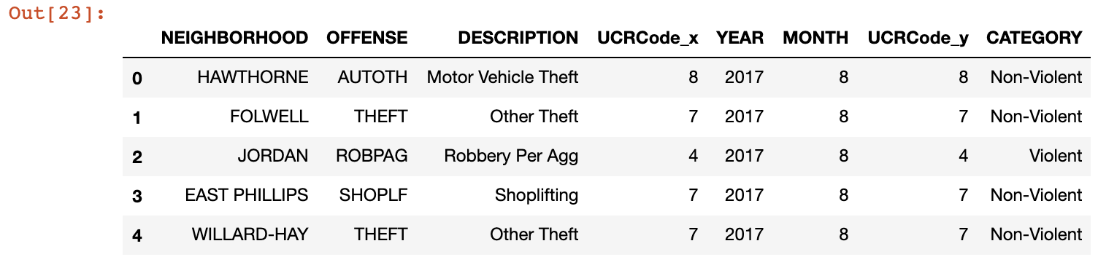
DATA CLEANING
Getting What We Need
Combine UCR Code Data with Police Data

Slide 16

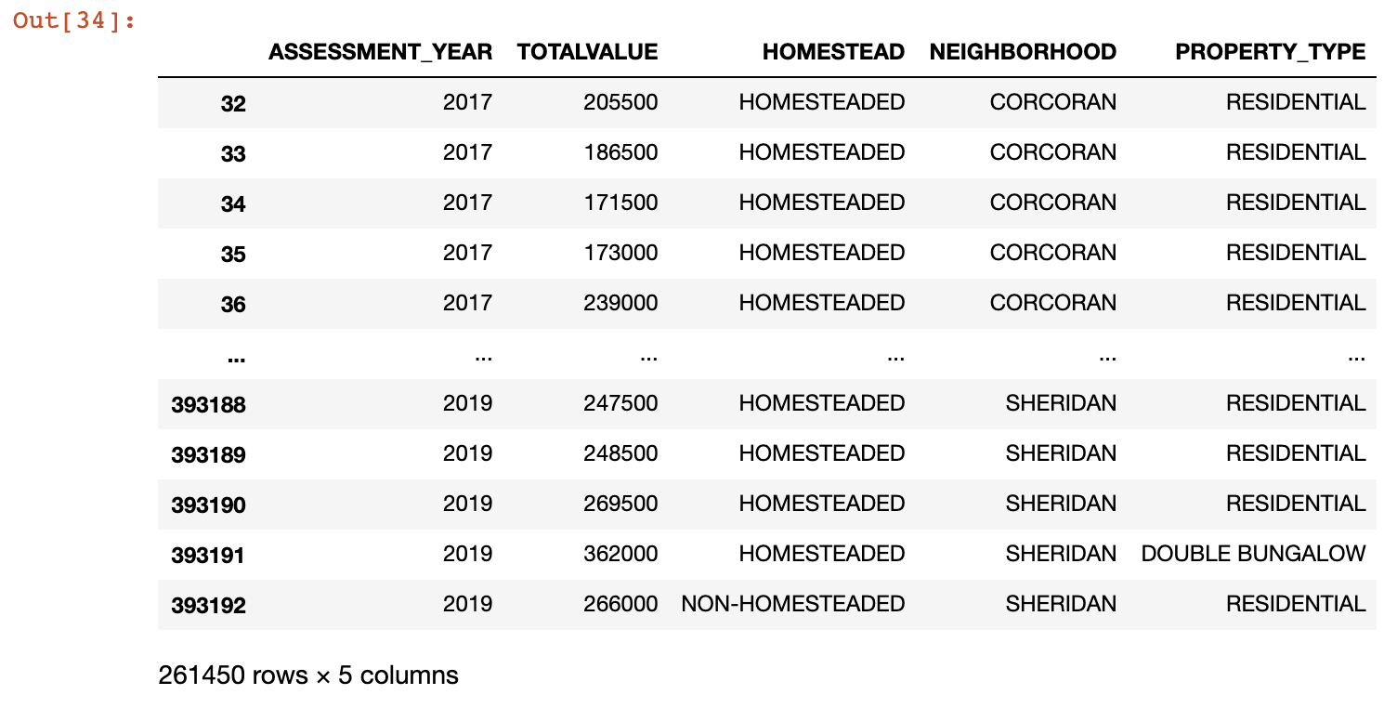
DATA CLEANING
Getting What We Need
Combine all data and grab only what we need

Slide 17
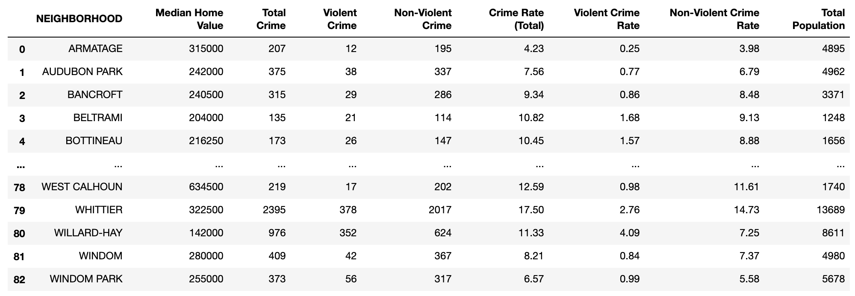
DATA CLEANING
Grouping by Neighborhood to get Median Values and Crime Totals

Slide 18
DATA CLEANING
Normalize data to get rates
Grouping by Neighborhood to get Median Values and Crime Totals

Slide 19

IMPORTANT DETAILS
+ ONLY FOCUSING ON RESIDENTIAL
+ MEDIAN PROPERTY VALUES
+ SUBJECTIVE NATURE OF VIOLENT/NON-VIOLENT
& PROPERTY TYPES TO EXCLUDE
+ 2017-2019 DATA SET

Slide 20


Slide 21


Slide 22

DATA EXPLORATION
Understanding the data and looking for patterns..
to answer questions
Is crime rate a function of the median housing value?
Is there less crime in high property value neighborhoods?
Is there more crime in low property value neighborhoods?
Does housing value have impact on the type of crime (violent vs non-violent crime)?

Slide 23
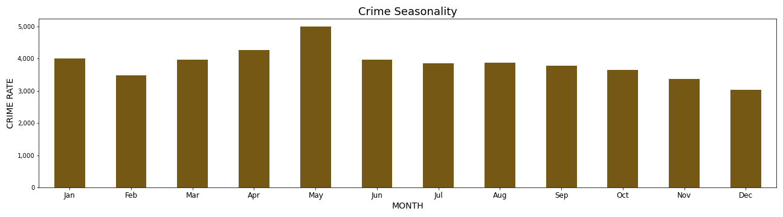
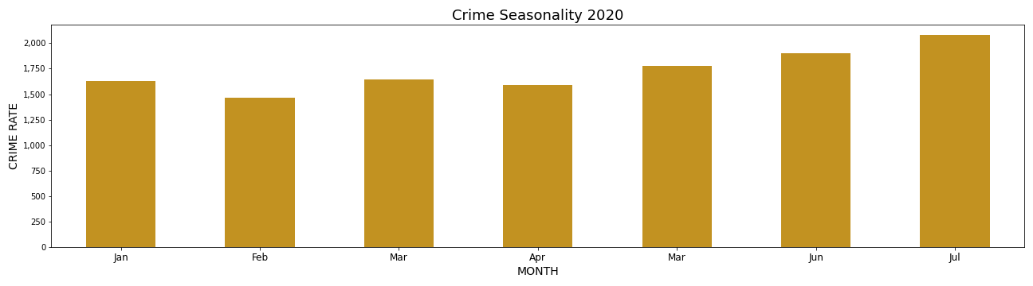
DATA EXPLORATION
2017 - 2019
It seems that there is less crime in higher value properties
Looking for patterns: seasonality

Slide 24
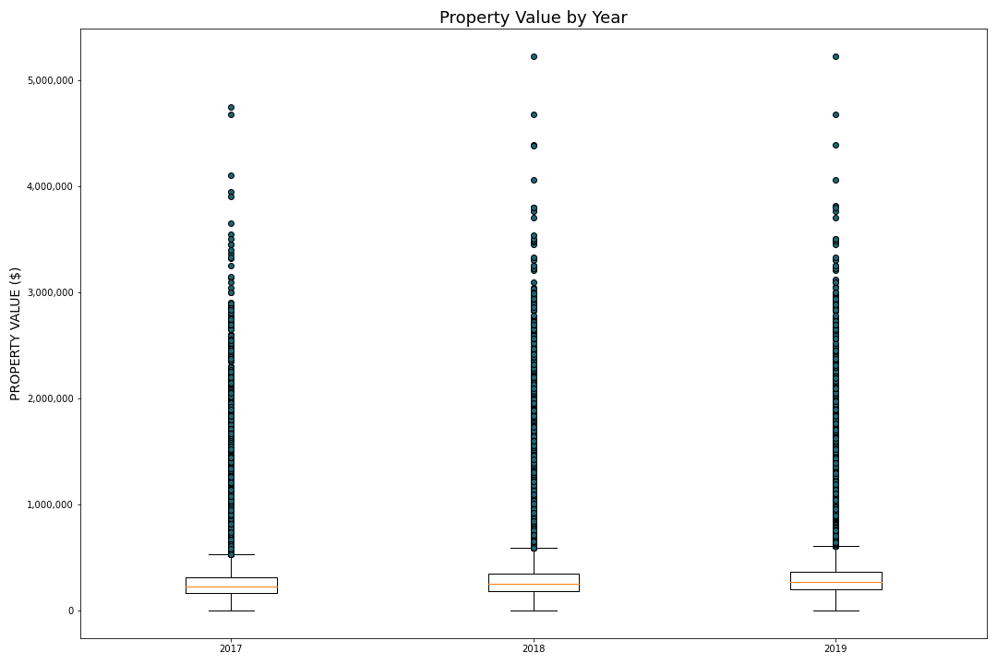
DATA EXPLORATION
Can the outliers tell us something about the data?
2017: 86,837
2018: 86,995
2019: 87,046

Slide 25
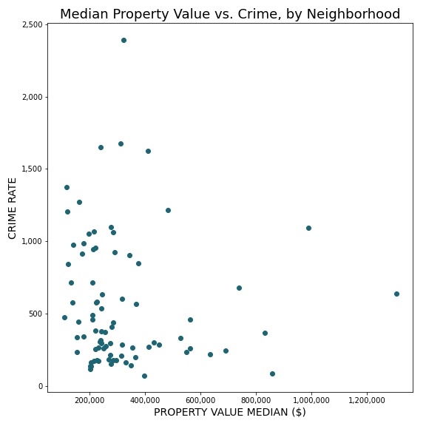
DATA EXPLORATION
There appears to be less crime amid higher value properties…

Slide 26
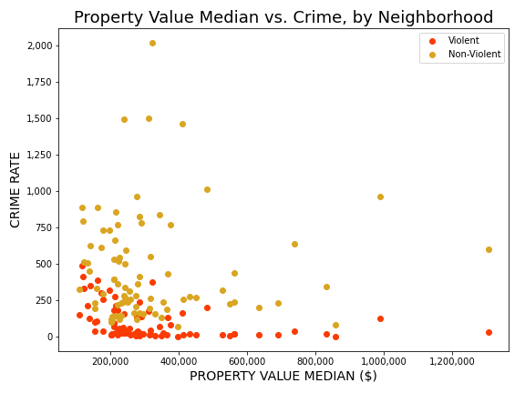
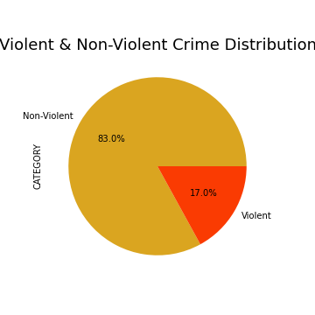
DATA EXPLORATION
…it also looks like the property value has an impact on the type of crime.

Slide 27
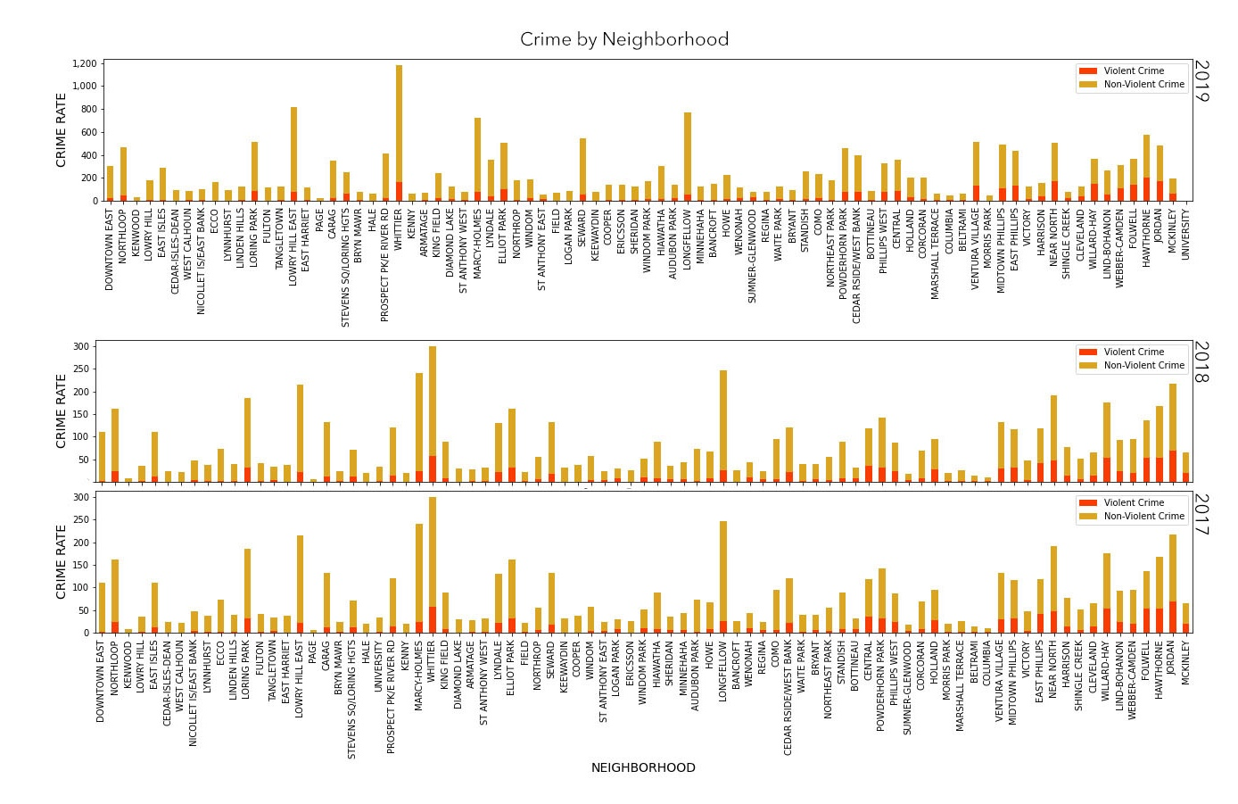
x15
x15
x15
x7
What if we sort the Neighborhoods by its property value mean, and split them by year?

Slide 28
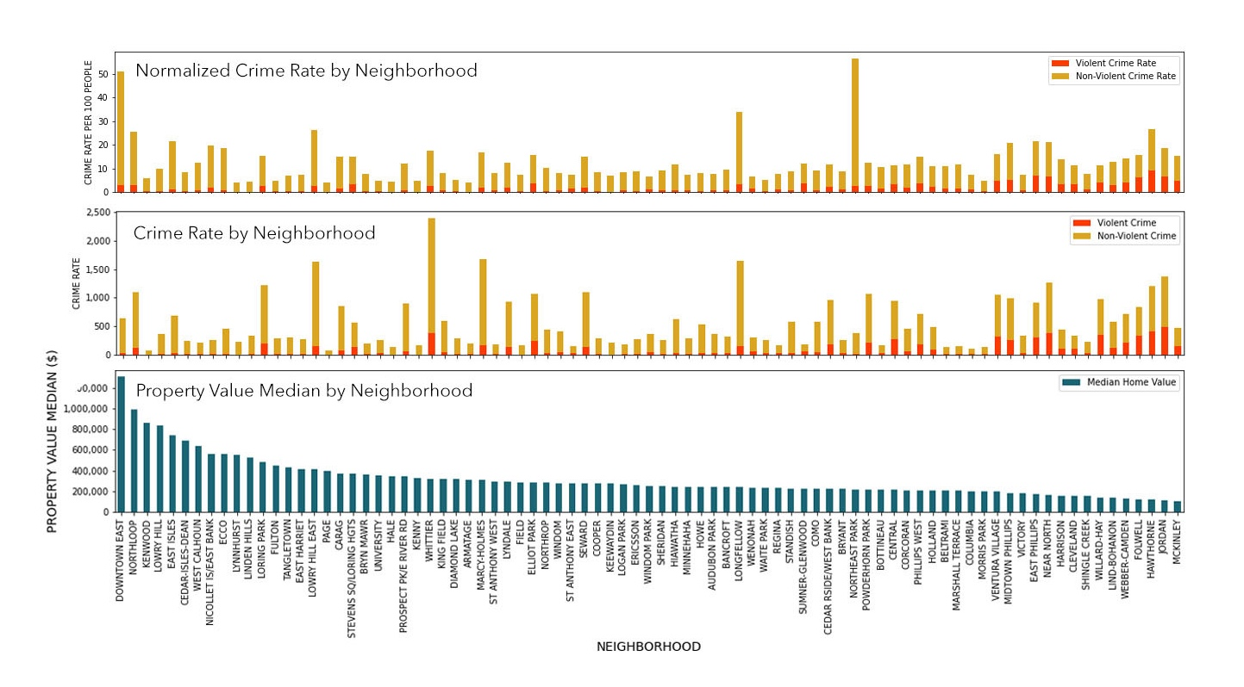
Does housing value have impact on the type of crime (violent vs non-violent crime)?

Slide 29
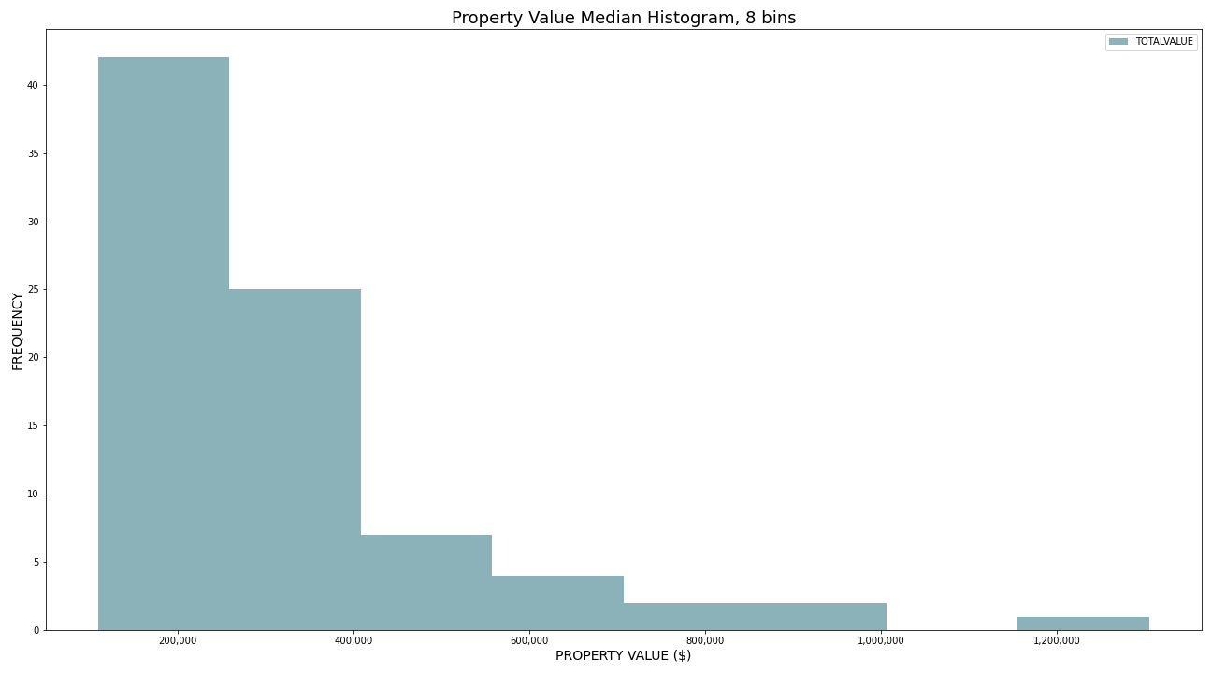
DATA EXPLORATION

Slide 30


Slide 31
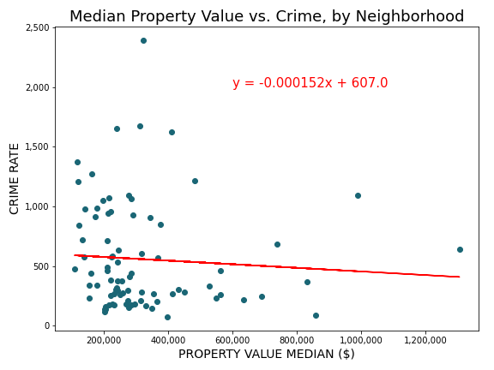
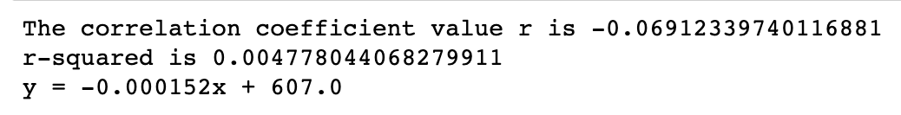
# Correlation and regression
Data from 2017 to 2019 could predict 2020 available data, if there is a strong correlation.

Slide 32
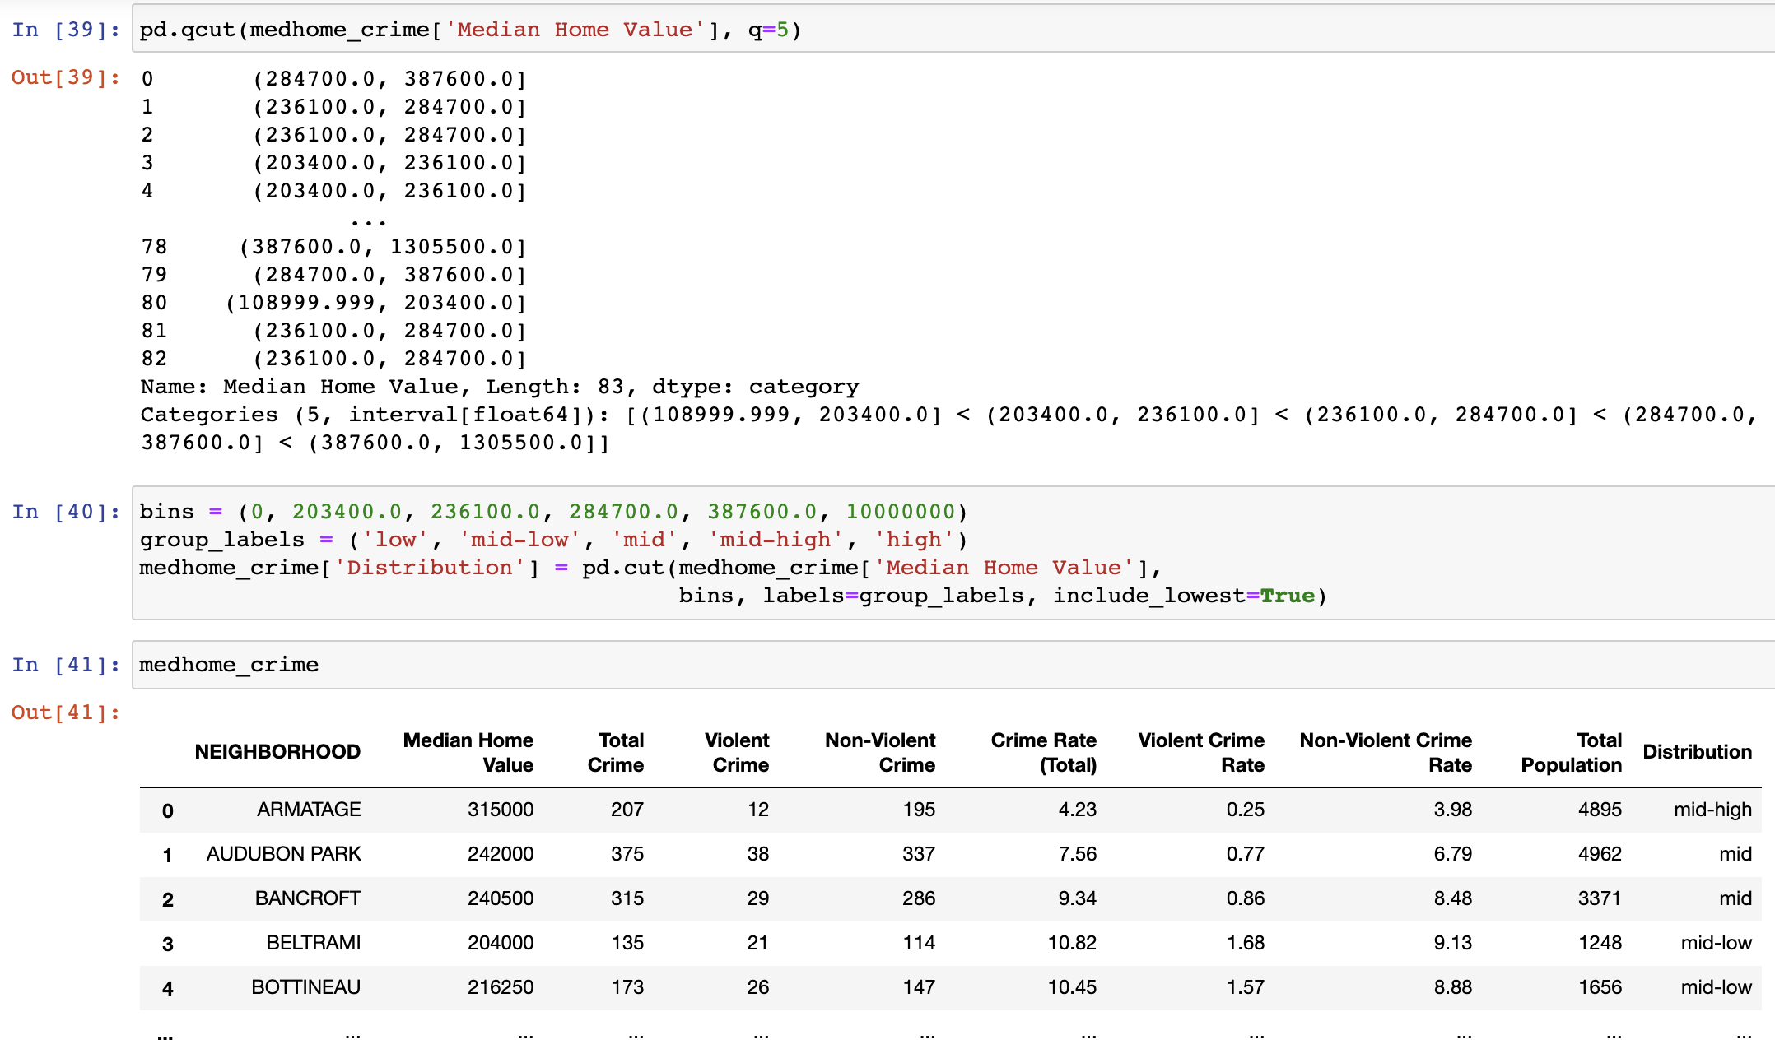
# Binning the independent variable

Slide 33
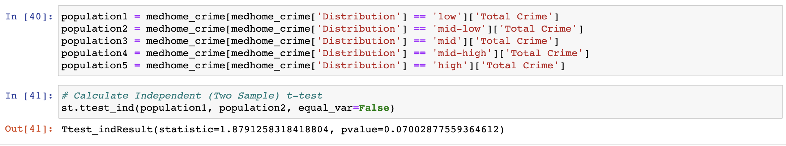
# Performing t-test analysis

Slide 34
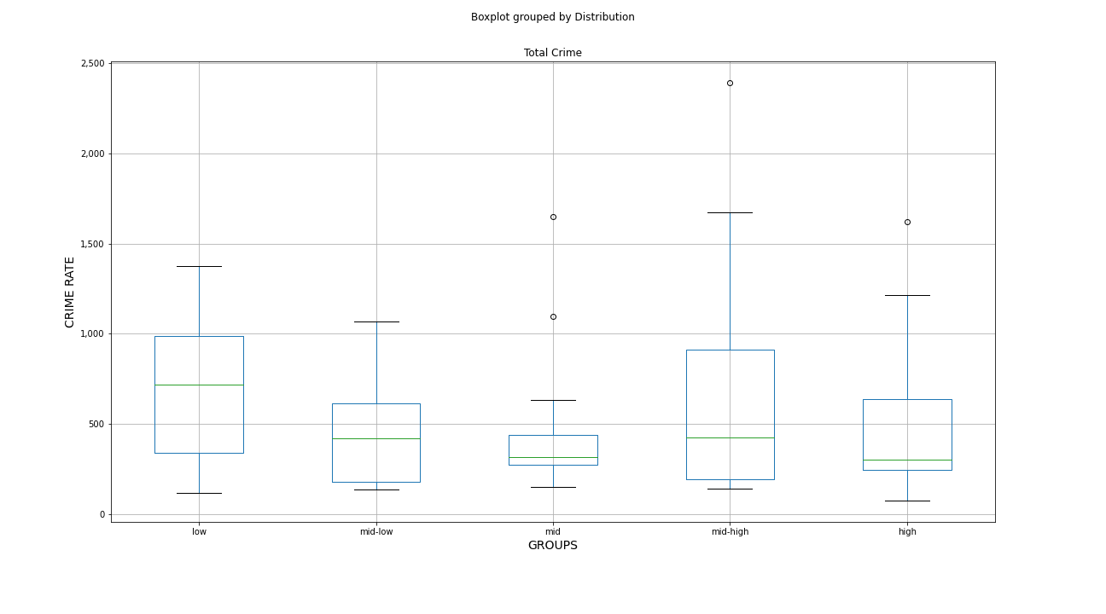
# Performing an Analysis of Variance

Slide 35
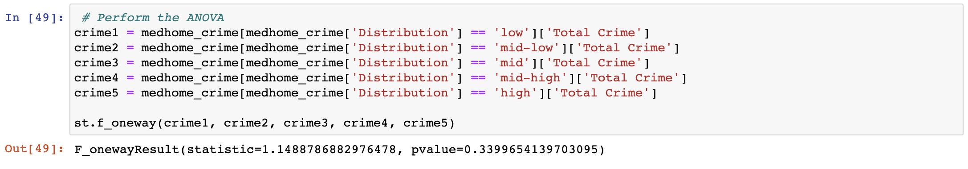
# Performing an Analysis of Variance

Slide 36
# Conclusions
Correlation and Regression:
The regression analysis showed a very week correlation coefficient of -0.069.
r-squared is small (0.0047), which reflects the scattered data.
The model wouldn’t be able to make an accurate prediction
t-test:
The p-values between the different groups are greater than the 0.05, meaning there is no statistical significance, and the null-hypothesis cannot be rejected.
ANOVA:
The overlapped boxplots signaled there is not a significant difference between the grouped values.
There is no sufficient evidence to reject the null hypothesis.

